Slide 1

Bioinformatics Bootcamp
Special Topic Workshop: “Single Cell RNA-Seq Analysis”
Module 4: Biological Interpretation

Slide 2
scRNA-Seq Downstream Analysis Workflow
Load Data
QC
Normalize & Scale
PCA & Nearest Neighbor Graph
Clustering
Advanced:
Cluster Marker Analysis
Cell Type Identification
Sub-clustering
Trajectories
Cell Cycle Analysis
Cluster DGE
Low Dimensional Embedding

Slide 3
scRNA-Seq Downstream Analysis Workflow
Load Data
QC
Normalize & Scale
PCA & Nearest Neighbor Graph
Clustering
Advanced:
Cluster Marker Analysis
Cell Type Identification
Sub-clustering
Trajectories
Cell Cycle Analysis
Cluster DGE
Low Dimensional Embedding

Slide 4
scRNA-Seq Downstream Analysis Workflow
Load Data
QC
Normalize & Scale
PCA & Nearest Neighbor Graph
Clustering
Advanced:
Cluster Marker Analysis
Cell Type Identification
Sub-clustering
Trajectories
Cell Cycle Analysis
Cluster DGE
Low Dimensional Embedding

Slide 5
scRNA-Seq Downstream Analysis Workflow
Load Data
QC
Normalize & Scale
PCA & Nearest Neighbor Graph
Clustering
Advanced:
Cluster Marker Analysis
Cell Type Identification
Sub-clustering
Trajectories
Cell Cycle Analysis
Cluster DGE
Low Dimensional Embedding

Slide 6
scRNA-Seq Downstream Analysis Workflow
Load Data
QC
Normalize & Scale
PCA & Nearest Neighbor Graph
Clustering
Advanced:
Cluster Marker Analysis
Cell Type Identification
Sub-clustering
Trajectories
Cell Cycle Analysis
Cluster DGE
Low Dimensional Embedding

Slide 7
scRNA-Seq Downstream Analysis Workflow
Load Data
QC
Normalize & Scale
PCA & Nearest Neighbor Graph
Clustering
Advanced:
Cluster Marker Analysis
Cell Type Identification
Sub-clustering
Trajectories
Cell Cycle Analysis
Cluster DGE
Low Dimensional Embedding

Slide 8
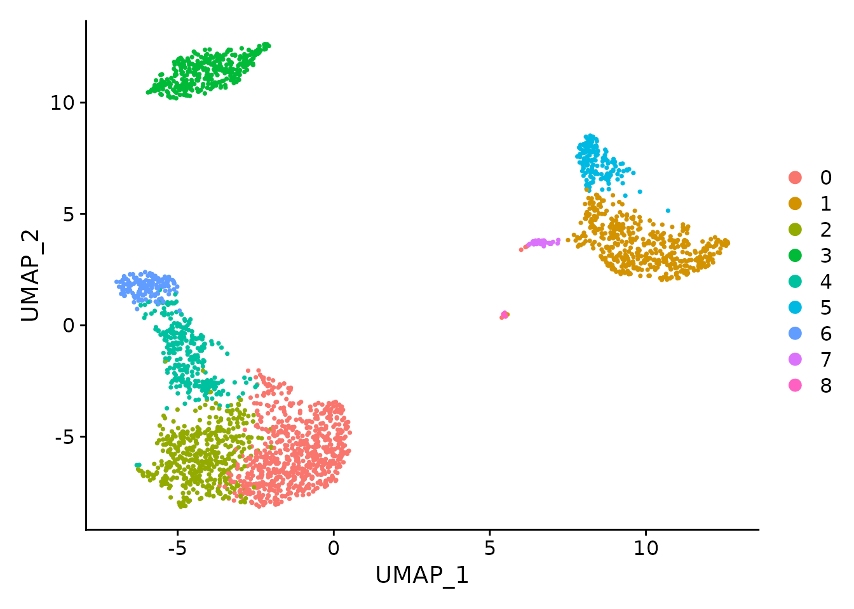
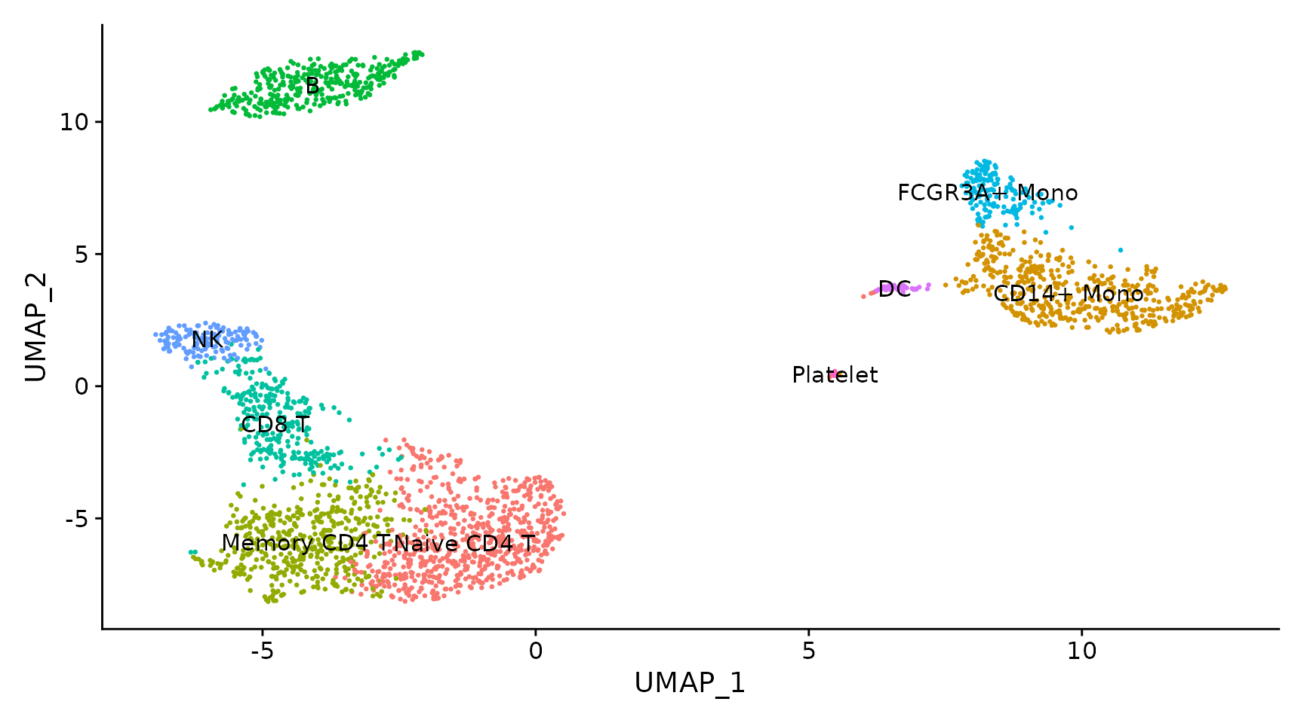
Cell Type Assignment

Slide 9
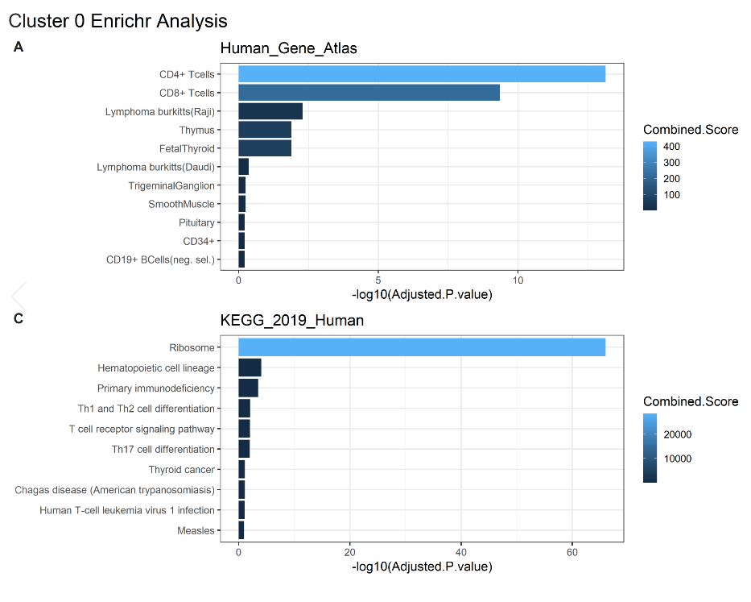
Cluster Marker Identification

